Slide 1
Smart Facial attendance monitoring system
MID TERM REPORT PPT
Presented by : Mayank Verma
Rahul Raj
Vivek Kumar

Slide 2
Introduction
This Project aims to revolutionize the traditional attendance taking method used in School and colleges.
It is designed to automatically capture the attendance of the students present in the class by recognizing their faces using an installed CCTV camera.
This Application uses “Image Processing” technique to take attendance.

Slide 3
1
2
3
The main objective is to automate the attendance monitoring system, that is shifting it from pen and paper attendance system to fully electronic monitoring system.
The application will not only provide necessary reports to the teacher but it will also provide valuable feedbacks and comments to the students also, through this they can also keep track of their attendance
To save the valuable time ,of both students and teachers that was getting consumed while taking attendance in every lecture.
This application will save at least 10 minutes in each lecture.
Objectives

Slide 4
Literature Findings:
Over the last decade, face recognition has become one of the most active applications of visual recognition due to its potential value for law enforcement, surveillance and human-computer interaction
Eigenface is one of the most thoroughly investigated approaches to face recognition.
It is also known as Karhunen- Loève expansion, eigenpicture, eigenvector, and principal component . In mathematical terms, eigenfaces are the principal components of the distribution of faces, or the eigenvectors of the covariance matrix of the set of face
images
Face recognition starts with the detection of face patterns in sometimes cluttered scenes, proceeds by normalizing the face images to account for geometrical and illumination changes, possibly using information about the location and appearance of facial landmarks, identifies the faces using appropriate classification algorithms, and post processes the results using model-based schemes and logistic feedback

Slide 5
Problem Formulation :
Currently to keep track of students attending the classes, the attendance records are taken manually
This process is not only tedious and also very time consuming , this manual method is easily prone to proxies, it is very difficult to manage and analyze the student data manually
Also if some analyzed information is required urgently then to obtain that ,is very difficult
To solve this problem we are providing a better alternative solution through our Smart Facial Attendance Monitoring System
This Application help them to take the attendance with the help of camera installed in the classroom by matching it to the preset facial data-set of students
The obtained attendance record is saved electronically in a system, that will be used for further analysis which in turn saves a lot of time, money and energy.

Slide 6
Technologies Used
Python
OpenCV
Tkinter
JavaScript
1
2
3
4
=
Python is a high-level, interpreted, interactive and object-oriented scripting language. Python is designed to be highly readable. It uses English keywords frequently where as other languages use punctuation, and it has fewer syntactical constructions .
OpenCV is an open source computer vision and machine learning software library. It has various algorithms can be used to detect and recognize faces, identify objects, classify human actions in videos, track camera movements
Tkinter is the standard GUI library for Python. Python when combined with Tkinter provides a fast and easy way to create GUI applications. Tkinter provides a powerful object-oriented interface to the Tk GUI toolkit
JavaScript is a lightweight, interpreted programming language. It is complimentary to and integrated with Java. JavaScript is very easy to implement because it is integrated with HTML. It is open and cross-platform.

Slide 7
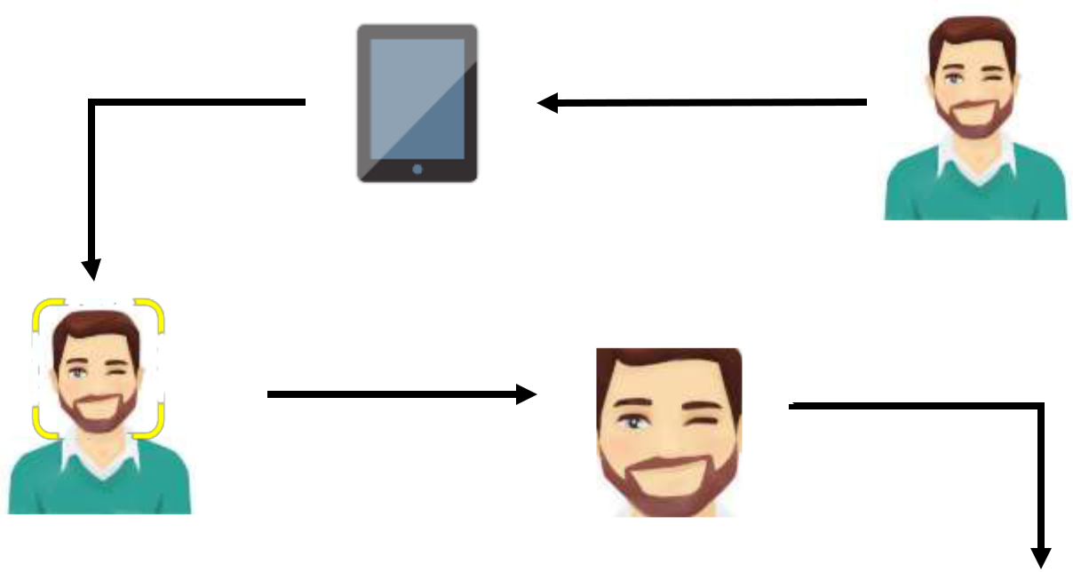

Generating Attendance Flow:
1. Student glances at the camera for Attendance
2. Student face is detected in real-time
4. The face is then identified by matching it with the recorded dataset.
3. The facial region of interest is grabbed from the frame
5.The attendance is marked for the “Present” students rest are marked “Absent”.

Slide 8
Conclusion :
Attendance monitoring is one of the important and repetitive task which is done in School and Colleges
every day in each lecture , which at least consumes 10 minutes in each lecture , for a college having
at least 6 lectures the total time consumed in taking attendance is more than 1 hour.
This project will help in reducing the time taken for attendance to nearly 0 , so that the time saved can be utilized in a more productive manner. It can provide a detailed attendance report which be useful for both teachers and students as well.
This project will be of huge help for the School/Colleges as it saves their lot of time, labor , and paperwork ,also as the attendance will be taken automatically , the chances of external interference and proxies are next to zero. The report generated is more accurate.

Slide 9
Thank You

